Slide 1
Facemask Detection using CNN to contain the spread of COVID-19
Team #2
Akshar Awari
Rohan Parkar
Sharvan Kanchan

Slide 2
Overview
Introduction
Data Exploration
Methodology 3.1 Data Preprocessing 3.2 Mining the data 3.3 Model Performance
Result
Conclusion

Slide 3
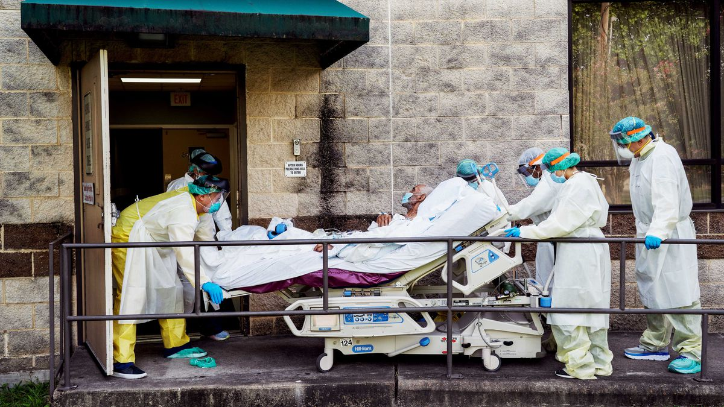
Introduction - Understanding the problem
The economic and social disruption caused by the Covid-19 pandemic is devastating: tens of millions of people are at risk of falling into extreme poverty, while the number of undernourished people is increasing. From school closures to devastated industries and millions of jobs lost – the social and economic costs of the pandemic are many and varied. Covid-19 is threatening to widen inequalities everywhere, undermine progress on global poverty and clean energy, and more.

Slide 4
Introduction - Facts and Figures
There were 75,725,243 confirmed cases of COVID-19 in the United States in the month of January 2022 reported to WHO.
893,870 deaths were recorded during the same month which proves that this virus can become deadly.
COVID-19 has impacted all walks of life and thus it is important to contain its spread.

Slide 5
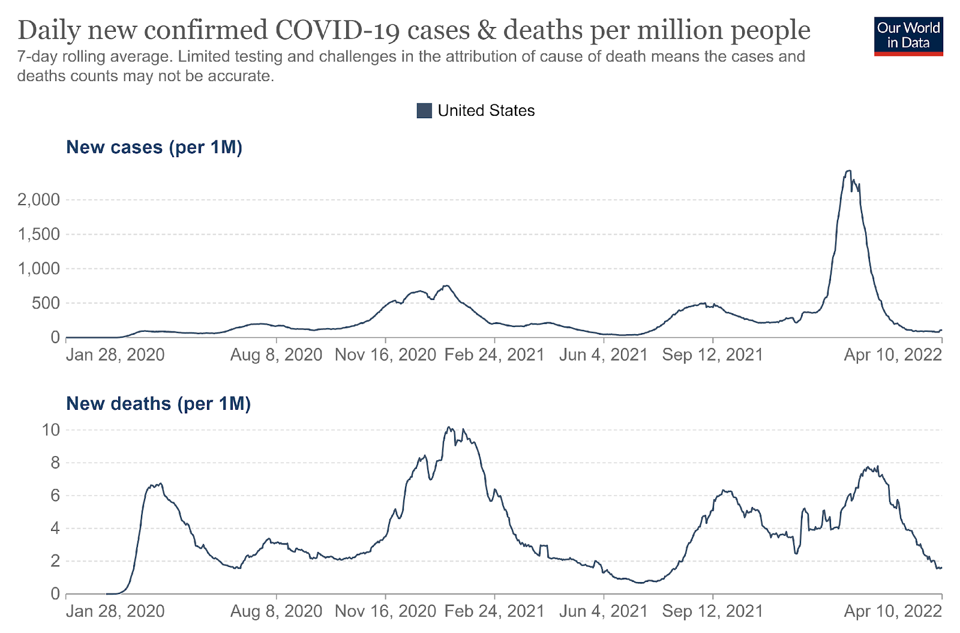
Fig.1 Confirmed Cases and Deaths graph

Slide 6
Introduction - Covid-19 and Masks
According to a study, wearing a facemask can lower the risk of infection by 70%.
As lives are starting to come to the normal again, the definition of “Normal” has changed and newer policies have been incorporated by various organizations.
Most common one is mask mandate across all the age groups and countries.
This system detects facemask on a face through a live video stream, thus ensuring the mask mandate is being followed.

Slide 7
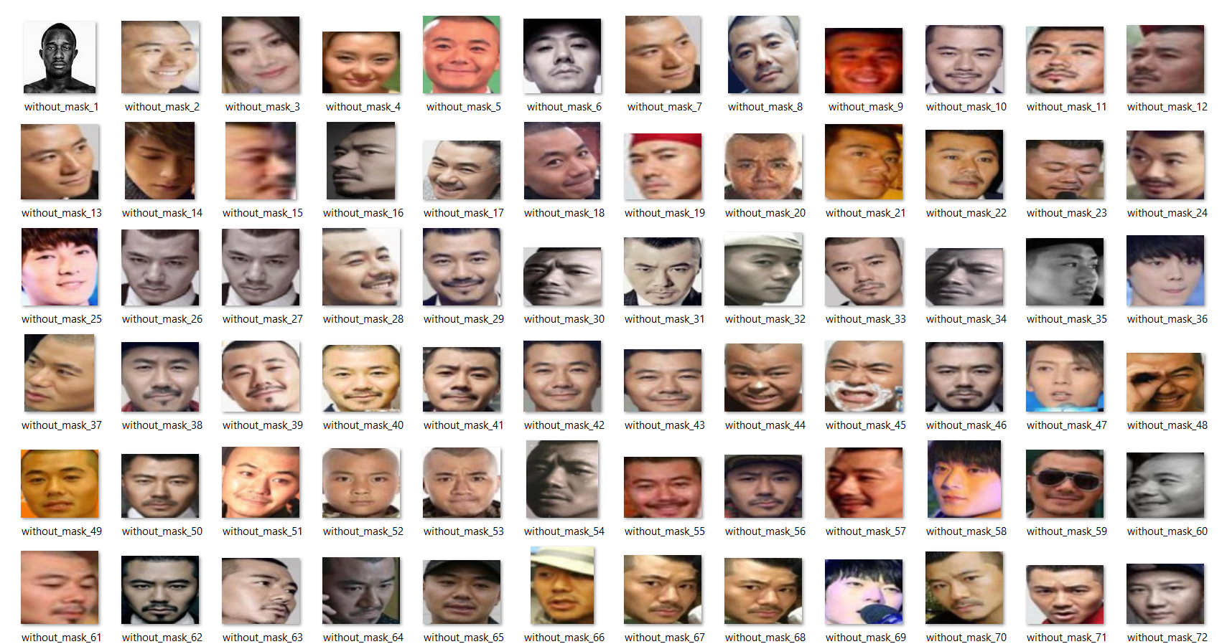
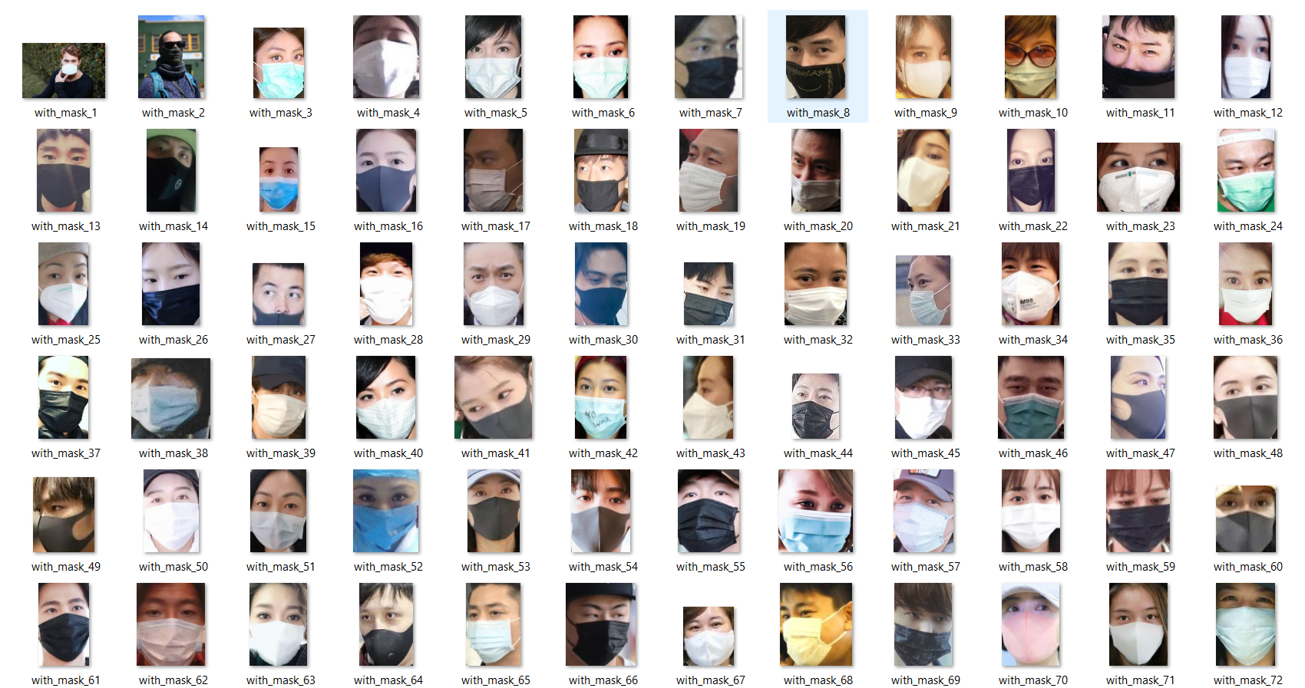
Data Exploration - Dataset snapshot
Fig 2. Images with mask
Fig 3. Images without Mask

Slide 8
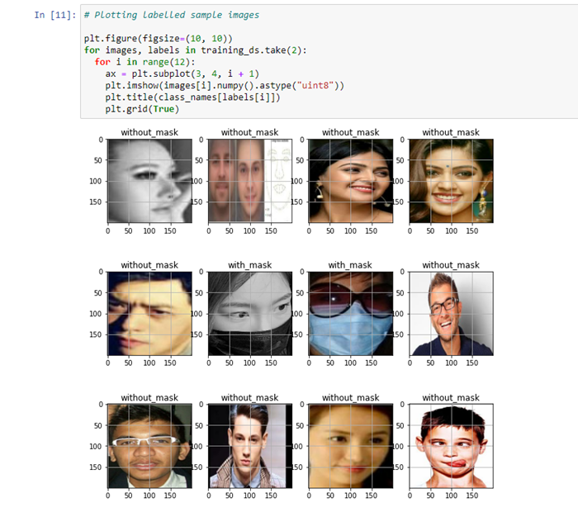
Data Exploration - Visualizing the data
The data consists of total 7553 images out of which 3725 and 3828 images classified as with and without mask respectively.
The image title is a text feature in our data frame as with_mask and without_mask.
A total of 6043 images have been used to train the model and 1510 images to test.
Fig 4. Labelled images with
mask and without mask

Slide 9

Methodology - Data Preprocessing
Converting BGR image to RGB.
Resizing images.
Converting images into NumPy matrix.
Rescaling all pixels from 0 to 1.
Converting target labels into one-hot vector.
Splitting dataset into train, test and validation set.

Slide 10
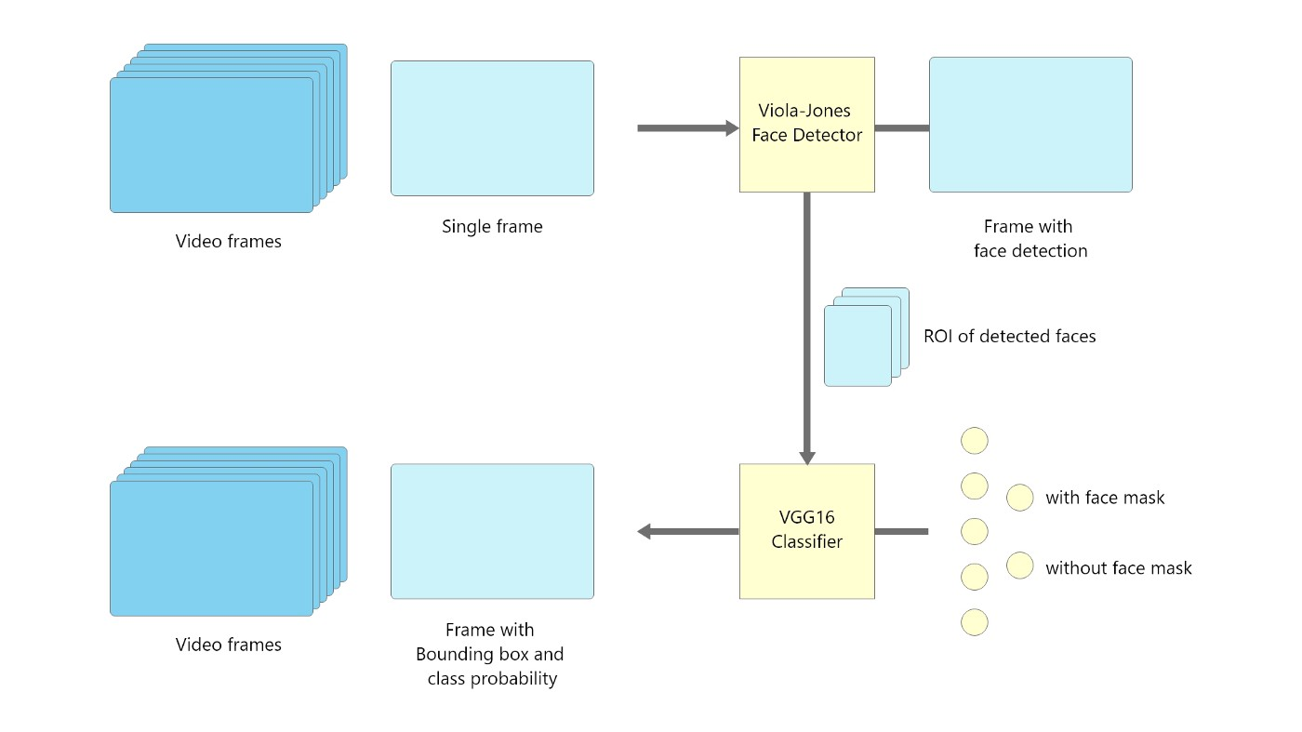
Methodology - Flow of the Project
This project works in two stages , firstly, detecting faces and then classification of the faces having face mask and without face mask
Fig 5. Flow of the project

Slide 11
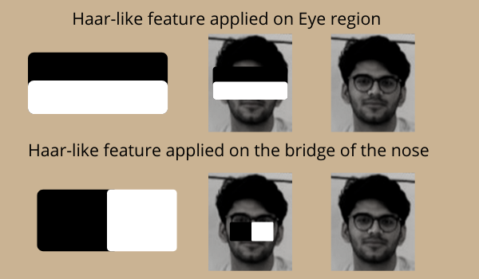
Methodology - Mining the data (1)
Face Detector
The Viola-Jones algorithm is used to detect faces which works on the basis of haar feature selection.
It discovers the position on the colored image after detecting the face on the grayscale image.
Viola-Jones draws a box and searches within it for a face
Fig 6. Haar-like features used by Viola jones

Slide 12
Methodology - Mining the data (2)
2. Face Mask Classifier (CNN)
The VGG16 architecture of CNN has been used to classify the faces with mask.
On ImageNet, the transfer learning approach to add 64 units as a fully connected layer (ReLU activation) and 2 units as an output layer to a pre-trained VGG16 (Softmax activation).
The model has been trained on ImageDataGenerator() method, which is a type of data augmentation on the dataset.

Slide 13
Methodology - Mining the data (3)
2. Face Mask Classifier (Support Vector Machine)
Model construction starts with creating support vector classifier.
Then with the help of GridSearchCV and parameters grid, create a model.
The data is then split into training and testing dataset as 80% training and 20% testing data.
Finally, the model is trained using training data and tested using testing data and final accuracy is computed in SVM.

Slide 14
Methodology - CNN vs SVM
SVM model produces an accuracy of 95%.
While CNN produces an accuracy of 98.41%.
For training 200 images SVM took 32 mins while CNN trained 7000 images in the average time of 47 mins.
It can be seen that SVM takes too much of time in comparison to CNN.
That is the reason why we decided to use CNN over SVM.

Slide 15
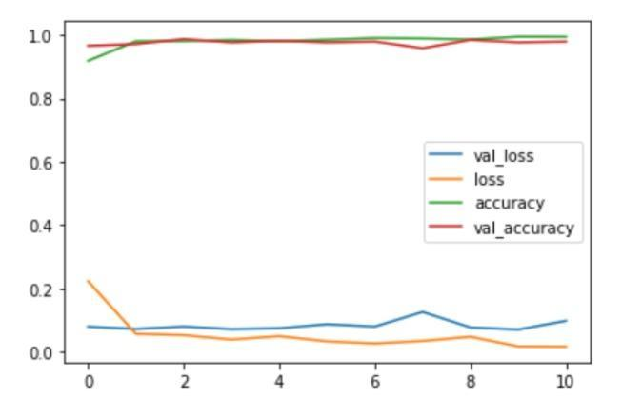
Model Performance - Accuracy & Confusion Matrix
Our model has completed 11 epochs with the training set , which has gained
98.41% Training accuracy
98.21% Validation accuracy
From the confusion matrix on the test set(384 samples), the results are:
True-positive and true-negative are 200 and 181 respectively
False-positive and false-negative are 1 and 2 respectively.
Fig 7. Accuracies and losses plotted

Slide 16
Model Performance - Classification Report
 | Precision | Recall | F1-score | Support
0 | 0.98 | 0.99 | 0.98 | 387
1 | 0.99 | 0.98 | 0.98 | 369
Accuracy |  |  | 0.98 | 756
Macro Avg | 0.98 | 0.98 | 0.98 | 756
Weighted Avg | 0.98 | 0.98 | 0.98 | 756
Fig 8. Classification performance of different modes

Slide 17
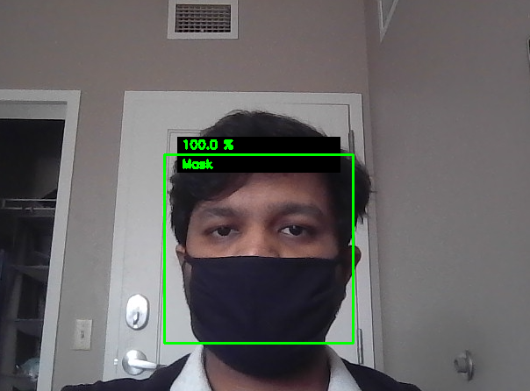
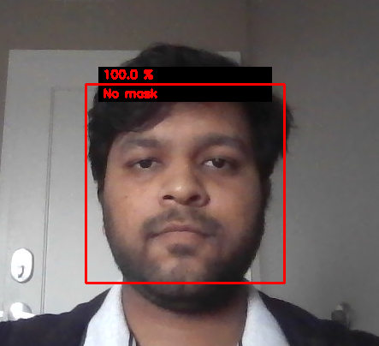
Result - Live output
Output on live camera feed
Fig 9. Face detected and classified with mask
Fig 10. Face detected and classified without mask

Slide 18
Conclusion - Model Throughputs and Improvements
We take live input from camera and detect whether a person is wearing a mask or not.
A box is drawn on the face of the person with the probability mentioned.
CNN architecture is used to train the model which achieved an accuracy of 98.41%.
SVM is compared with CNN using various performance parameters.
In the comparison we found that CNN performs better on our data as it has less execution time than SVM.
The model performance and throughput can be enhanced by using Intel’s OpnenVino toolkit for machine without GPUs and Nvidia's Cuda for machines with dedicated GPUs.

Slide 19
Conclusion - Future Scope and Applications
This is a perfect application for businesses like Vicon, Saavi, Sony, Bosch.etc and others that provide video surveillance services.
These companies are responsible for their own cameras, video management servers, and video analytics.
This application can bring them clients such as hospitals, mining zones, contaminated locations, and other places where masks are required.
Basically, they detect if someone's not wearing a mask and either alert them or raise an alarm based on the emergency at the location or circumstance.

Slide 20
References
[1] Witten, I. H., Frank, E., Hall, M. A., & Pal, C. (2016). Data Mining: Practical Machine Learning Tools and Techniques. Elsevier Science & Technology. http://ebookcentral.proquest.com/lib/rit/detail.action?docID=4708912
[2] Zhang, D. (2019). Fundamentals of Image Data Mining: Analysis, Features, Classification and Retrieval. Springer International Publishing. https://doi.org/10.1007/978-3-030-17989-2
[3] Introduction to Data Mining. (n.d.). Retrieved April 18, 2022, from https://www-users.cse.umn.edu/~kumar001/dmbook/index.php

Slide 21
Thank You!

